Slide 1

Data Analysis & Business Insights Dashboard
Name: Sharvari Puranik
Role: Data Analysis

Slide 2
Business Problem Statement
Businesses generate large amounts of sales data.
But raw data alone cannot support decision-making.
This project analyzes sales trends, customer segments, product performance, and profit behavior to generate actionable insights.
The objective was to transform raw business data into actionable insights using Python and Power BI.

Slide 3
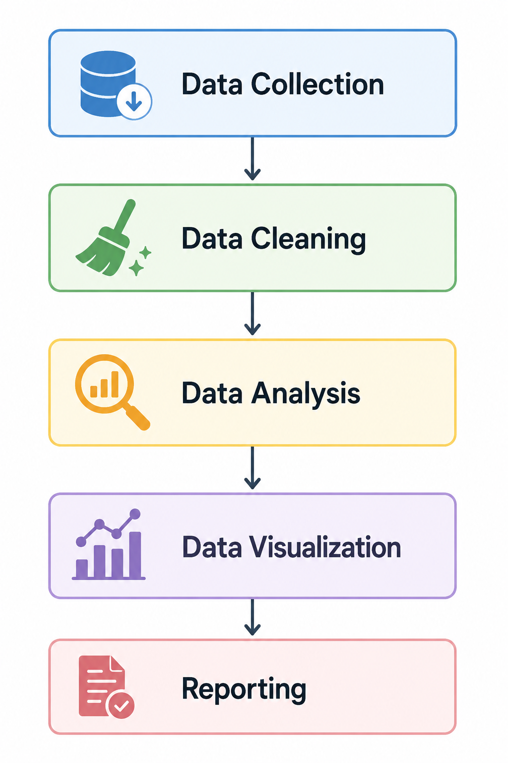
Project Workflow

Slide 4

Technology Uses
Technology Usage
Python Data Processing
Pandas Cleaning & Transformation
Matplotlib Charts
Power BI Dashboard
Github Project Hosting

Slide 5

Data Preparation
Removed duplicate values
Filled missing/null values
Corrected data types
Standardized column format
Exported clean dataset

Slide 6
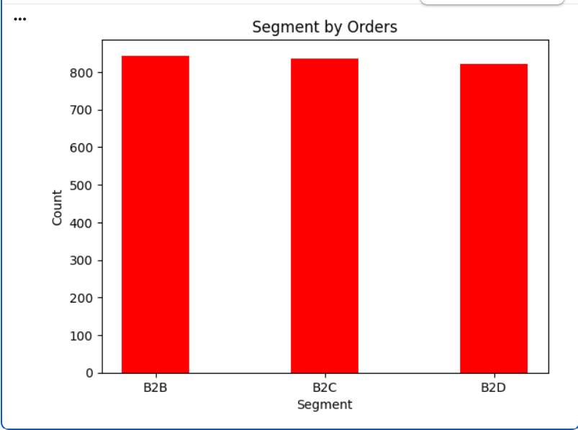
Customers Segment by Orders
Insights
B2B segment has the highest number of orders.
B2C segment is slightly lower than B2B.
B2D segment has the lowest orders among all segments.
Order distribution is almost equal across all segments.
All customer segments contribute consistently to overall business performance.

Slide 7
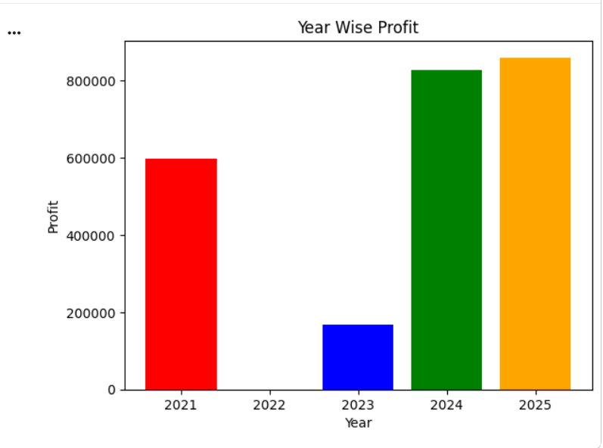
Year Wise Profit
Insights
2025 recorded the highest profit, showing the best business performance.
2024 also generated very high profit, close to 2025.
2021 showed stable profit performance compared to earlier years.
2023 had significantly lower profit, indicating weak performance.
Profit growth increased strongly after 2023, showing business recovery and improvement.

Slide 8
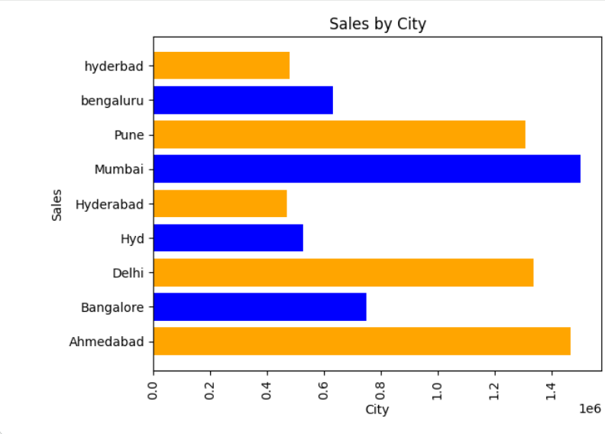
Sales By City
Insights
Mumbai recorded the highest sales, making it the top-performing city.
Ahmedabad, Delhi, and Pune also contributed high sales revenue.
Bangalore and Bengaluru show moderate sales performance.
Hyderabad-related entries have comparatively lower sales.
Metro cities contribute the largest share of overall sales growth.

Slide 9
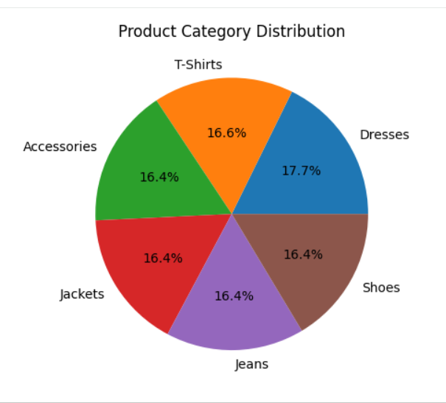
Product Category Distribution
Insights
Dresses category has the highest share, showing slightly higher customer demand.
T-Shirts, Shoes, Jeans, Jackets, and Accessories have nearly equal distribution.
Product demand is balanced across all categories.
No single category dominates overall sales significantly.
The business has a diversified product portfolio, reducing dependency on one category.

Slide 10
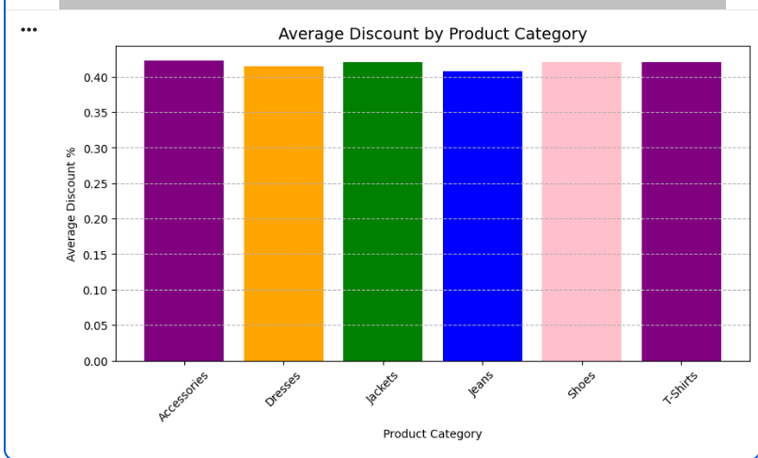
Average Discount By Product Category
Insights
Discount percentages are almost equal across all product categories.
Accessories, Jackets, Shoes, and T-Shirts have slightly higher average discounts.
Jeans category has the lowest average discount compared to others.
No major variation is seen in discount strategy across categories.
The business follows a consistent discount policy for all product categories.

Slide 11
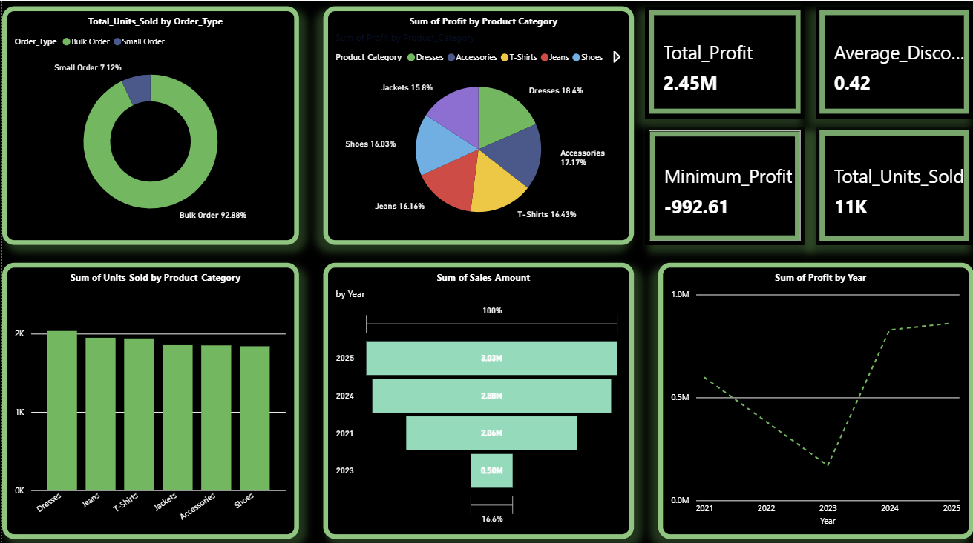
Interactive Dashboard
An interactive dashboard was created to monitor business performance by analyzing sales, profit, discount, product categories, and order trends. It helps stakeholders make data-driven decisions.

Slide 12
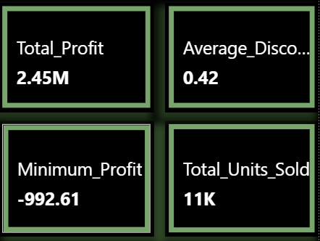
KPI Cards Analysis
Components:
Total Profit = 2.45M → Overall profit generated by business.
Average Discount = 0.42 → Average discount provided on products.
Minimum Profit = -992.61 → Lowest profit/loss transaction recorded.
Total Units Sold = 11K → Total quantity of products sold.
Business Insight
Business generated strong overall profit with high sales volume.

Slide 13
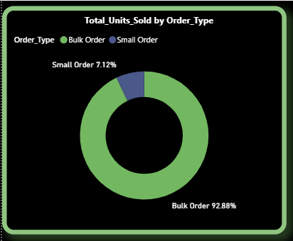
Order Type Distribution
Bulk orders contribute the highest percentage of units sold.
Small orders represent a smaller share of sales.
Bulk customers significantly drive revenue generation.

Slide 14
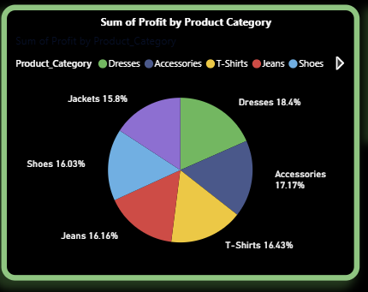
Profit By Product Category
Profit is distributed across multiple product categories.
Dresses and Accessories contribute slightly higher profit.
Product categories perform consistently overall.

Slide 15
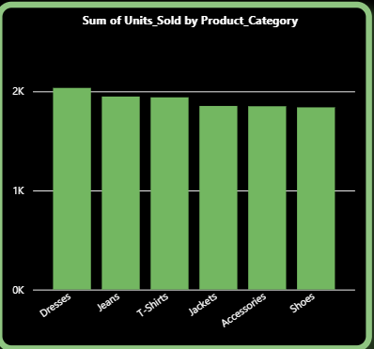
Units Sold by Product Category
Units sold are balanced across all product categories.
Dresses and Jeans show slightly higher product demand.
Indicates stable customer demand pattern.

Slide 16
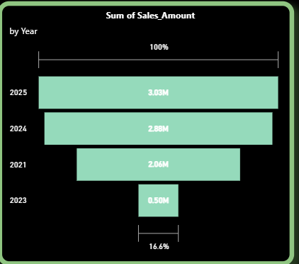
Sales Amount by Year
Sales revenue increased gradually over the years.
2025 recorded the highest sales amount.
Indicates positive business growth trend.

Slide 17
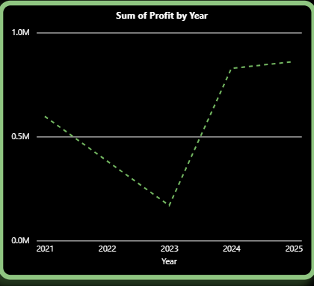
Profit Trend Analysis
Profit decreased significantly during 2023.
Recovery started from 2024 onward.
Highest profit growth observed in 2025.

Slide 18
Project Conclusion
The sales data analysis project successfully transformed raw business data into meaningful insights using Python, Excel, and Microsoft Power BI.
Key Findings
• The business generated a total profit of 2.45M, showing strong overall performance.
• Bulk/B2B orders contributed the highest sales volume, making them an important revenue driver.
• Mumbai and other major cities generated higher sales, indicating strong regional performance.
• Product categories showed balanced demand, with some categories contributing slightly higher profit.
• Business experienced a profit decline in 2023, followed by strong recovery and growth in 2024–2025.
• Discount percentages remained consistent across product categories, reflecting a stable pricing strategy.
• The interactive dashboard enables real-time monitoring of sales, profit, product performance, and business growth trends.

